Slide 1
Predictive Maintenance of Industrial Machinery
CAPSTONE PROJECT
Presented By:
MOHAN RAAJ C
SATHYABAMA INSTITUTE OF SCIENCE AND TECHNOLOGY
BE CSE
AICTE Student ID: STU682c0ae6bea981747716838

Slide 2
OUTLINE
Problem Statement (Should not include solution)
Proposed System/Solution
System Development Approach (Technology Used)
Algorithm & Deployment
Result (Output Image)
Conclusion
Future Scope
References

Slide 3
Problem Statement
Develop a predictive maintenance model for a fleet of industrial machines to anticipate failures before they occur. This project will involve analyzing sensor data from machinery to identify patterns that precede a failure. The goal is to create a classification model that can predict the type of failure (e.g., tool wear, heat dissipation, power failure) based on real-time operational data. This will enable proactive maintenance, reducing downtime and operational costs.

Slide 4
Proposed Solution
The proposed system aims to address the challenge of predicting industrial machine failures before they occur, enabling proactive maintenance and reducing downtime. This involves leveraging machine learning techniques with IBM AutoAI to accurately classify failure types based on operational sensor data
The solution will consist of the following components:
Data Collection:
Gather historical sensor readings from industrial machines, including air temperature, process temperature, rotational speed, torque, and tool wear.
Use the Kaggle Predictive Maintenance dataset as the primary training source.
Data Preprocessing:
Clean and preprocess the dataset to handle missing values, outliers, and inconsistencies.
Standardize measurement units and encode categorical variables like machine type.
Feature Engineering:
Extract and select the most relevant sensor parameters that influence machine failure patterns to improve prediction accuracy.
Machine Learning Algorithm:
Utilize IBM AutoAI to automatically build and evaluate multiple classification pipelines (e.g., Logistic Regression, Random Forest, Gradient Boosting, XGBoost).
Select the best-performing model to classify failure types such as Tool Wear, Power Failure, Heat Dissipation, Overstrain, and No Failure.
Deployment:
Deploy the best-trained model to IBM Cloud Deployment Space as an online prediction service.
This allows engineers to input real-time sensor readings and receive instant predictions of failure types.
Evaluation:
Assess the model’s performance using accuracy, precision, recall, and F1-score metrics from the AutoAI leaderboard.
Choose the model with the highest accuracy (~99%) for deployment.
Result:
The system provides accurate, real-time predictions of machine failure types, enabling maintenance teams to take corrective actions before breakdowns occur, reducing downtime and operational costs.

Slide 5
System Approach
The system approach outlines the strategy and methodology for building the predictive maintenance model using IBM AutoAI.
System Requirements:
IBM Cloud Lite account
Watsonx.ai (AutoAI) service
IBM Cloud Object Storage for dataset storage
Kaggle Predictive Maintenance dataset (CSV file)
Libraries/Tools Used (handled by AutoAI):
Scikit-learn, XGBoost, LightGBM (used internally by AutoAI)
IBM Watson AutoAI framework for pipeline generation and model evaluation
Technology – Use of IBM cloud lite services is mandatory.
This setup ensures scalability, ease of deployment, and integration with real-time prediction services.

Slide 6
Algorithm & Deployment
Algorithm Selection:
IBM AutoAI automatically evaluates multiple classification algorithms (e.g., Logistic Regression, Random Forest, Gradient Boosting, XGBoost, and Neural Networks). The system selects the best-performing pipeline to classify machine failure types such as Tool Wear, Power Failure, Heat Dissipation, Overstrain, and No Failure.
Data Input:
The input features used for training include:
Air temperature [K],Process temperature [K],Rotational speed [rpm],Torque [Nm],Tool wear [min],Machine Type (L, M, H)
The target column is Failure Type.
Training Process:
ExplainThe dataset (~10,000 records) is uploaded into IBM AutoAI,AutoAI automatically splits the dataset into training and validation sets.,Multiple pipelines are trained with hyperparameter tuning.,Performance is evaluated using accuracy, precision, recall, and F1-score.,The top-ranked pipeline (~99% accuracy) is chosen.
Prediction Process:
The trained model is deployed to IBM Cloud Deployment Space as an online service,New sensor readings (temperature, speed, torque, tool wear) are given as inputs.,The deployed model predicts the failure type in real time with a confidence score.,Industry users can use this output for proactive maintenance planning.

Slide 7
Result
Model achieved ~99% accuracy in predicting machine failure types.
Successfully classified failures: Tool Wear, Power Failure, Heat Dissipation, Overstrain, No Failure.

Slide 8
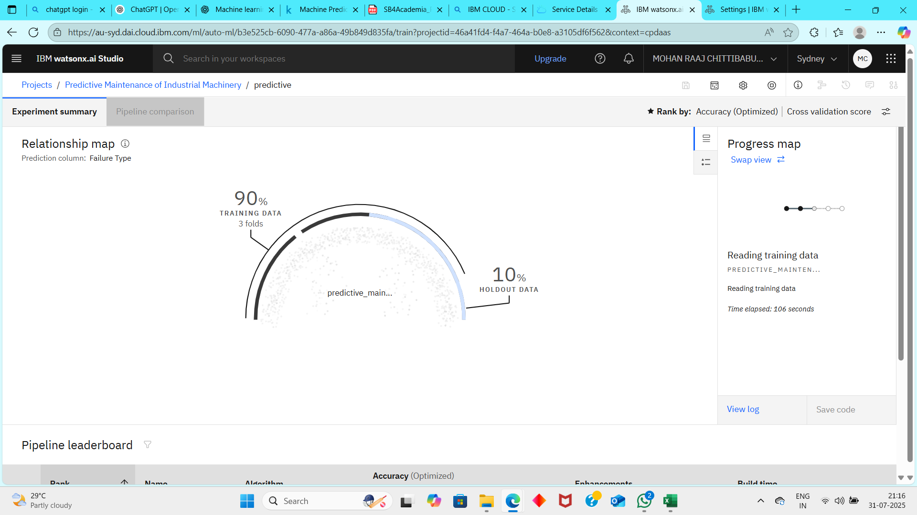
Result

Slide 9
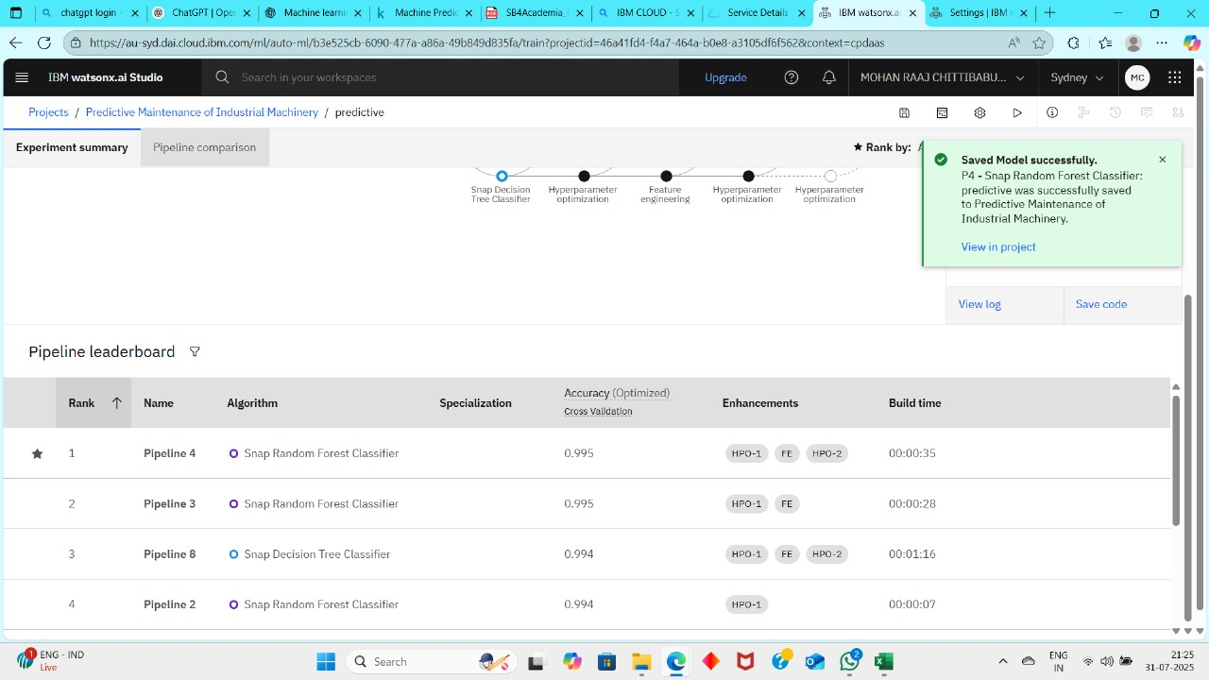
Result

Slide 10
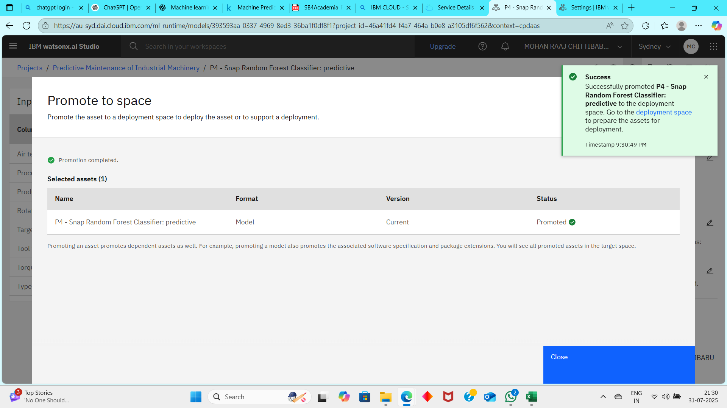
Result

Slide 11
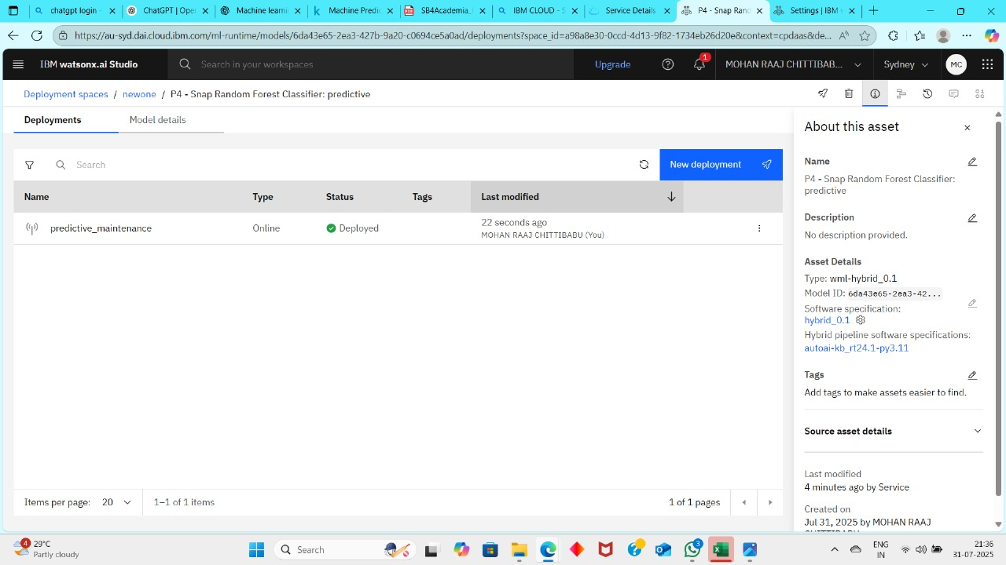
Result

Slide 12
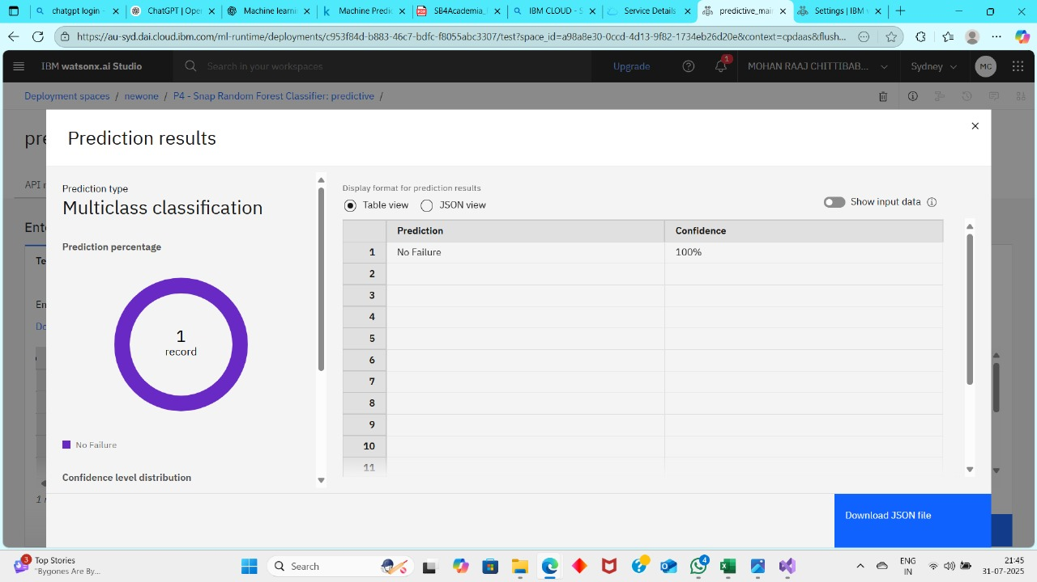
Result

Slide 13
Conclusion
Developed a predictive maintenance model using IBM AutoAI.
The model can classify failure types accurately before they occur.
Enables industries to shift from reactive to proactive maintenance.
Reduces unplanned downtime and optimizes operational efficiency.

Slide 14
Future scope
Integrate real-time IoT sensor data for continuous monitoring.
Predict Remaining Useful Life (RUL) of machine components.
Deploy in large-scale industrial plants for automated maintenance alerts.
Expand dataset with more machine types and operating conditions for higher accuracy.

Slide 15
References
Kaggle Dataset:Predictive Maintenance of Industrial Machinery
https://www.kaggle.com/datasets/shivamb/machine-predictive-maintenance-classification
IBM Cloud AutoAI Documentation
https://dataplatform.cloud.ibm.com/docs/content/wsj/analyze-data/autoai-overview.html
IBM Watsonx.ai and Cloud Object Storage official documentation

Slide 16
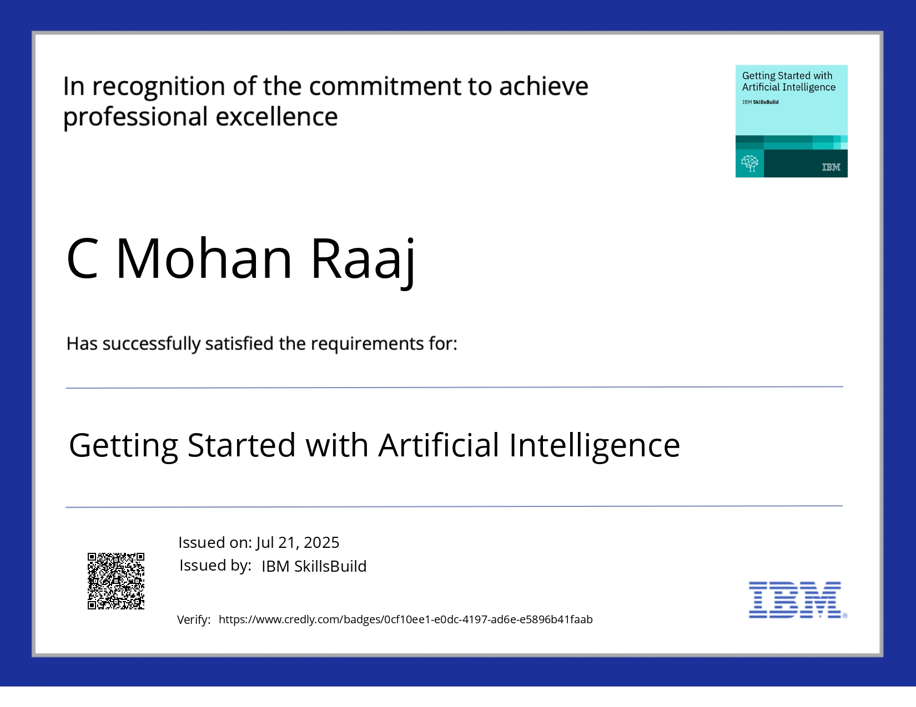
IBM Certifications

Slide 17
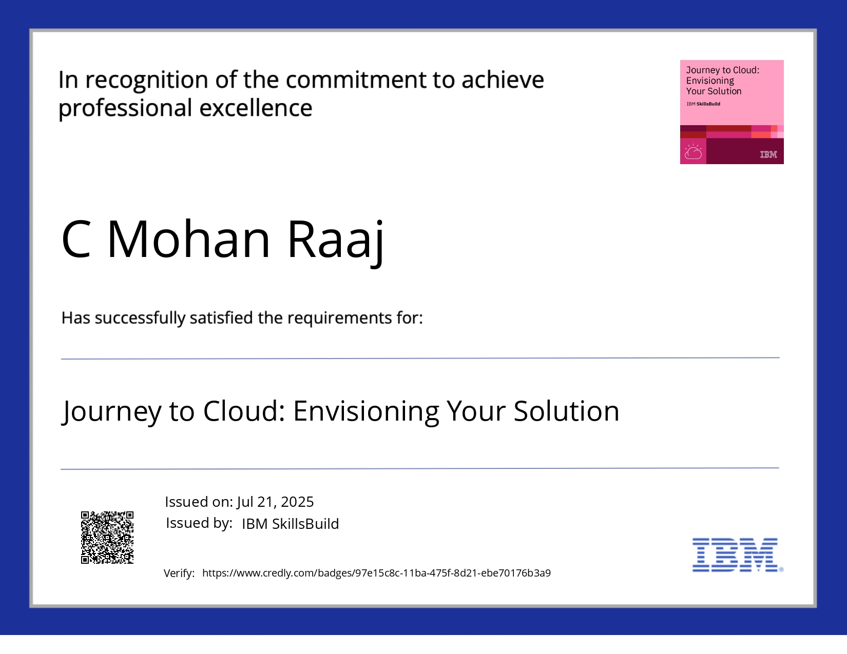
IBM Certifications

Slide 18
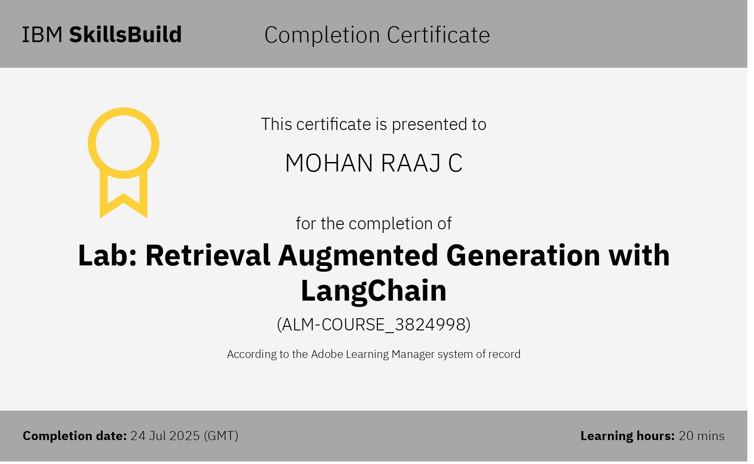
IBM Certifications

Slide 19
THANK YOU

